Slide 1
Romans

Slide 2
Book of Romans Mindset
Not written in modern style
Modern expectation of structure can cause confusion
A symphony of topics (minor and major) all working towards an overarching theme – God’s Righteousness
The “Anatomy” of salvation - macro and micro

Slide 3
Background and History
Author: Apostle Paul
Audience: Church(es) in Rome
Date: 56 A.D.
Location: Corinth
Purpose: Doctrine of Soteriology

Slide 4
Definitions
Righteousness – Greek Dikaioun
  “The quality of being morally right or justifiable” –google
  To be right (in a moral sense, moreover in Gods eyes)
  Sinless
  To do no wrong
Justification/to justify – Greek Dikaioo
  Legal term
  To declare righteous
  To remove the guilt from someone
  To pardon their sins and crimes wipe the record clean
  The bible declares the God is always both Righteous and Just

Slide 5
Definitions
Faith
  “Faith is the substance of the things hoped for, the evidence of the things not seen.” Hebrews 11:1
  “Faith is a living, daring confidence in God’s grace, so sure and certain that a man would stake his life on it a thousand times.” – Martin Luther
  Trust in God
    In His faithfulness, In His word, in His promises etc…
Grace
  Grace is, simply put, the enabling power of God for us to do what we could not have done on our own
  Grace is also unmerited favor
  Karma gives us what we deserve, grace gives us what we do not deserve

Slide 6
Definitions
Law
  The old testament with all the rules and regulations
  When Paul refers to “the law” in Romans it means to the old covenant made between God and Israel when they looked to obedience to those laws and commandments as the way to be accepted by God
  The law that is used to reveal Sin and demand obedience
Sin
  Greek hamartia: missing the mark
    Falling short of the standard, breaking the law (standard); lawlessness
  To pervert something
    To twist the original purpose or intended use of something towards an entirely wrong end
    i.e money to greed, political power to abuse, sex to porn and trafficking, hobbies to irresponsibility, work to neglect of personal life, friends and family to codependency

Slide 7
Augustine on Sin
“Sin arises when things that are a minor good are pursued as though they were the most important goals in life. If money or affection or power are sought in disproportionate, obsessive ways, then sin occurs. And that sin is magnified when, for these lesser goals, we fail to pursue the highest good and the finest goals. So when we ask ourselves why, in a given situation, we committed a sin, the answer is usually one of two things. Either we wanted to obtain something we didn’t have, or we feared losing something we had.”
Augustine, The Confessions of St. Augustine, Christian Classics in Modern English translated by Bernard Bangley (Shaw Books, 2000), 41.

Slide 8
Definitions
Spirit
  Body (world conscious), soul (self conscious), and spirit (God conscious)
  Spirit is how we connect with God, a bridge so to speak
  It longs for God and obedience and receives from Him
  Our “inner man”
  Different than the Holy Spirit who is God, which connects with our spirit
  Our spirit died when we Sinned in Adams disobedience and Jesus brought it back to life by the Holy Spirit through His obedience

Slide 9
Definitions
Flesh
  Our rebellious nature against God
  Leads us to disobey, rebel, and go against God and His commandments
  It cannot understand spiritual things, refuses to submit, hates being told what to do/ corrected, by nature hostile towards God, abuses freedom, demands to be fed, and fuels Sin
  Flesh is also the part that seeks to trust in all things but God
    It seeks to trust itself or other men as saviors and seeks to be its own God
    It seeks to sit on the throne of our lives and rule
    Flesh moves us to trust in our will, our strength, our emotions, our intellect, our abilities, our talents etc. as humans
    The bible makes a distinctions that flesh is separate from God and His spirit, and they cannot comingle
    God can not work with it, or make it better, or train it, He says it must die and be replaced

Slide 10
Federal/Seminal Headship
Adam
Jesus
Sin
Death
Condemnation
Disobedience
Sin increased
Sin reigned
Death reigned
Righteousness
Enteral Life
Justification
Obedience
Grace abounded
Grace reigned
Reigning in Life

Slide 11
Typology
Adam
Jesus
Authority over all creation
Tempted and failed
Those born in Adam inherited Sin
Disobedience led to death
Gave authority over to Satan
Authority over all creation
Tempted and passed
Those born-again inherited righteousness
Obedience lead to life
Took authority back from Satan

Slide 12
Big Picture Recap on Romans
Chapter 1-3
Gods righteousness required
Chapters 3b-5
Gods righteousness revealed in Jesus Christ
Chapters 6-8
Gods righteousness only possible by Holy Spirit
Chapters 9-11
Gods righteousness vindicated
Chapters 12-15
Gods righteousness reflected in practice

Slide 13
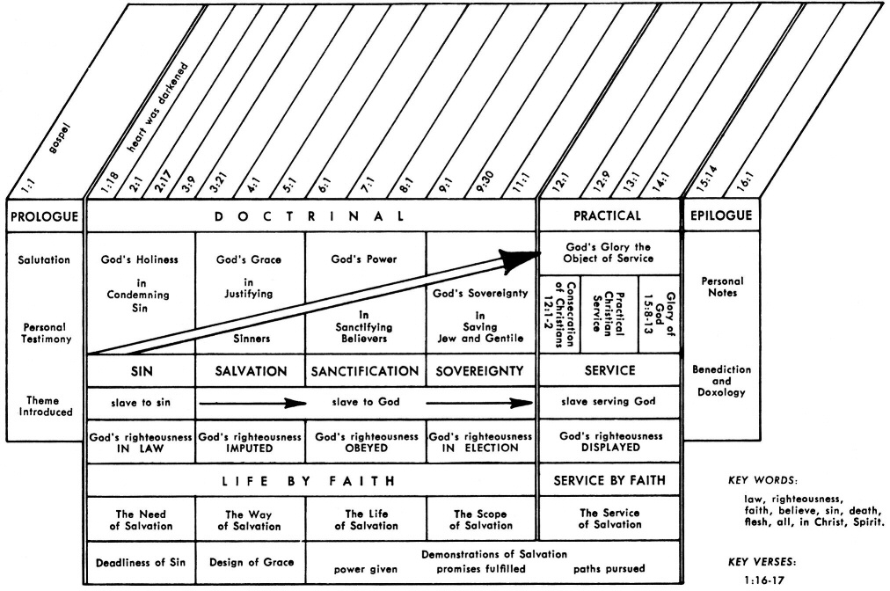

Slide 14
